Slide 1
Introduction to Project Management
Week 1

Slide 2
Introduction
Project management is an important aspect for a success of system development project.
In a study 1994 by Standish Group on success and failure rate of system development projects.
The surprising initial results indicated that almost 32 percent of all development projects were cancelled before they were completed.
In addition, more than half of computer system projects cost almost double the original budget. Less than half (about 42 percent) had the same scope and functionality as originally proposed.

Slide 3
Introduction Cont.
In fact, many systems were implemented with only a portion of the original requirements satisfied.
Depending on company size, completely successful projects (on time, on budget, with full functionality) ranged from only 9 percent to about 16 percent.
Clearly, system development is a difficult activity requiring very careful planning, control, and execution.

Slide 4
Introduction Cont.
Some primary reasons that projects fail, or are only partially successful, include the following:
Incomplete or changing system requirements
Limited user involvement
Lack of executive support
Lack of technical support
Poor project planning (including inadequate risk assessment)
Unclear objectives (including unreasonable expectations)
Lack of required resources

Slide 5
Introduction Cont.
Additional studies of successful projects help to highlight some reasons that projects succeed:
Clear system requirement definitions
Substantial user involvement
Support from upper management
Thorough and detailed project plans
Realistic work schedules and milestones
Successful projects result from strong project management that ensures the preceding success characteristics are an integral part of the project.

Slide 6
Introduction Cont. Why is software project management important?
First, there is the question of money. A lot of money is at stake with ICT projects. For example in 2003, UK government spent more on contracts for ICT projects than contracts related to roads (about £2.3 billion as opposed to £1.4 billion)
Unfortunately, project are not always successful. The reason for these project shortcomings is often the management of projects.
Among other factors causing project failure identified ‘lack of skills and proven approach to project management and risk management’

Slide 7
Introduction Cont. Why is software project management important?(2)
Complex project needs coordination of:
Multiple people
Multiple resources (labs, equipment, etc.)
Multiple tasks – some must precede others
Multiple decision points – approvals
Phased expenditure of funds
Matching of people/resources to tasks

Slide 8
Introduction Cont. Why is software project management important?(3)
Managers are faced with the problem of putting together and directing large temporary organizations while being subjected to constrained resources, limited time, and environmental uncertainty.
To cope with the complexity and uncertainty, new forms of project organization and management have evolved.

Slide 9
Introduction Cont.
Project management is the discipline of planning, organizing and managing resources to bring about the successful completion of specific project goals and objectives.
Project management is “the application of knowledge, skills, tools and techniques to project activities to meet project requirements” (PMI).
Project managers must not only strive to meet specific scope, time, cost and quality goals of projects, they must also facilitate the entire process to meet the business needs and manage risks.

Slide 10
Introduction Cont.
A project is “a temporary endeavour undertaken to create a unique product or service” (PMI).
A program is “a group of related projects managed in a coordinated way to obtain benefits and control not available from managing them individually” (PMI).
Programs are managed by program managers or directors who manage the work of the individual project managers.

Slide 11
Introduction Cont. Characteristics of Projects
A project is temporary. A project has a definite beginning and a definite end.
A project has a unique purpose. Every project should have well-defined objectives that are aligned to the business benefit.
A project requires resources. work is performed to achieve the project goals and require resources. These include human resources, materials and equipment.

Slide 12
Introduction Cont. Characteristics of Projects (2)
A project should have a sponsor. Projects need governance. Projects have many interested stakeholders, but an individual or a group must take the primary role of sponsorship. The project sponsor usually provides the direction and funding for the project.
A project involves uncertainty. Projects create change in an environment of change. Projects will be performed in the future in an environment of unknown and uncertainties.

Slide 13
Introduction Cont. Characteristics of Projects (3)
A project uses progressive elaboration. Only through analysis and realization steps will be specific details of the project become apparent.
Therefore, project need an incremental development approach. Initial project documents are updated progressively with more details based on new information acquired throughout project phases.

Slide 14
Introduction Cont. Project Governance
Project governance refers to the design and implementation of formal principles, structures, processes and communications that need to exist for a successful project program.
Project governance is the framework within decisions are made on projects. Figure 1 is a project governance framework.
Project governance:
Establishes the relationship between all internal and external groups involved in the project.

Slide 15
Figure1: project governance framework
Policy | Principles Ethics
Structure | Board Roles & responsibilities Approvals
Processes | Procedures Work instructions Tools & templates
Communication | Stakeholders Reporting Training

Slide 16
Introduction Cont. Project Governance (2)
Describes the flow of project information to all stakeholders.
Ensures the appropriate review of issues encountered within each project.
Ensures that required approvals and direction for the project is obtained at each appropriate stage of the project.
Project governance is initiated under umbrella of corporate governance, appoints a governing body for a project and makes a significant contribution to addressing the following concerns:

Slide 17
Introduction Cont. Project Governance (3)
The business case – by stating the business benefits to achieve and the objectives of the project, specifying the in-scope and out-of-scope elements.
Identified stakeholders – with an interest in business case and the project.
The business-level requirements – as agreed by all stakeholders.
A stakeholder communication plan
Agreement on project deliverables – and mechanism to assess the compliance of the completed project to its original objectives.

Slide 18
Introduction Cont. Project Governance (4)
An appointed project manager.
Clear project roles and responsibilities assignment – providing a basis for decision making.
A published project development plan – updated throughout the project phases.
A clear set of processes – to manage risks, issues, scope changes and quality.
A project review and progress-reporting process – including quality and documentation assessments.

Slide 19
Introduction Cont. Project Manager Job Description
Manages, prioritizes, develops, and implements solutions to meet business needs.
Applies technical, theoretical, and managerial skills to satisfy project requirements.
Builds and maintains an effective and open communication networked with sponsors and key stakeholders.
Coordinates and integrates team and individual efforts and builds positive professional relationship with stakeholders and external providers.
Conducts and coordinates business analysis, requirement gathering, project planning, schedule and budget estimating, development, testing and implementation.

Slide 20
Introduction Cont. Project Manager Job Description(2)
Manages project risks and prepares contingency plans.
Control implementation activities to fulfill identified objectives
Institutes and manages the project change control process
Establishes cross-functional teams for organizational readiness.
Acts as a link between internal users and external providers to develop and implement solutions
Responsible for external providers to ensure development is completed in a timely , high quality and cost-effective manner.
Provides post implementation support.

Slide 21
Introduction Cont. Project Manager Expected Skills Set
The project manager needs to develop wider hard and soft skills. These skills revolve around:
Organization and management
Technical (subject matter expertise)
People and communication
Administration.

Slide 22
Introduction Cont. Project Manager Expected Skills Set: Organization and Management
Project managers should possess general management knowledge and skills. These include: strategic planning, tactical planning, organizational structure and behaviours, operation management, personnel administration, compensation, benefits, career paths, financial management, accounting, procurement, sales, marketing, contracts, manufacturing, distribution, logistics, supply chain management and health and safety practices.

Slide 23
Introduction Cont. Project Manager Expected Skills Set: Technical
It is very important for project manager to communicate and understand the technicalities of the project with the project team.
Small projects require more technical skills than large projects.

Slide 24
Introduction Cont. Project Manager Expected Skills Set: People and Communication
Project managers communicate internally with the project members and externally with sponsors, stakeholders, upper and line managers, peers, and external providers.
Project manager need to communicate, lead, negotiate, solve problems, and influence the organization at large. The need to be able to listen actively to all project players, promote need approaches of solving problems and influence others to work toward achieving the project goals. Project managers must be open, pragmatic, realistic, flexible, creative.

Slide 25
Introduction Cont. Project Manager Expected Skills Set: People and Communication(2)
The most significant characteristics of effective project managers are as follows:
Convey the corporate goals clearly
Articulate the project directives visibly
Be inspirational
Be decisive
Lead by example
Be a good communicator
Be a good motivator
Be technically competent
Align team members
Support team members
Encourage innovation and creativity
Challenge top management decisions when necessary

Slide 26
Introduction Cont. Project Manager Expected Skills Set: Administration
Project administration functions are different from project management functions.
The scope of project administration is to collect, collate, monitor, and provide information relating to the management of projects, including work schedules, financial and budgetary data, requirements and reporting as required.
The project manager also performs, or oversees, the following administration activities:
Review project administration procedures and prepare guidelines, staff instruction, project administration memorandum, and handbook

Slide 27
Introduction Cont. Project Manager Expected Skills Set: Administration(2)
Monitor and evaluate implementation and development performance
Analyze progress reports
Compile and report project statistics
Present progress, unaudited and audited project accounts, and financial statements
Monitor project cash flows
Review and approve key and major documents
Monitor compliance
Recruit and staff project resources
Coordinate training programs

Slide 28
Introduction Cont. Nine Project Management Knowledge Areas
Knowledge areas describe the key competencies that project managers must develop
4 core knowledge areas lead to specific project objectives (scope, time, cost, and quality)
4 facilitating knowledge areas are the means through which the project objectives are achieved (human resources, communication, risk, and procurement management)
1 knowledge area (project integration management) affects and is affected by all of the other knowledge areas

Slide 29
Introduction Cont. Project Management Knowledge Areas
The four core knowledge areas of project management are as follows:
Project scope management involves defining and managing all the work required to complete the project successfully.
Project time management includes estimating the duration to complete the work, developing a project schedule and ensuring timely completion of the project.
Project cost management describes the processes involved in preparing and managing the budget for the project.
Project quality management ensures that the project will satisfy the undertaken quality requirements.

Slide 30
Introduction Cont. Project Management Facilitating Areas(2)
The four facilitating knowledge areas are the processes through which the project objectives are achieved. These include:
Project human resource management is concerned with planning, acquisition, and effective management of the project team.
Project communications management involves generating, collecting, disseminating, and storing project information.
Project risk management includes identifying, analyzing, responding to and controlling risks related to the project.
Project procurement management involves acquiring or procuring products, goods, and services for a project from outside the performing organization.

Slide 31
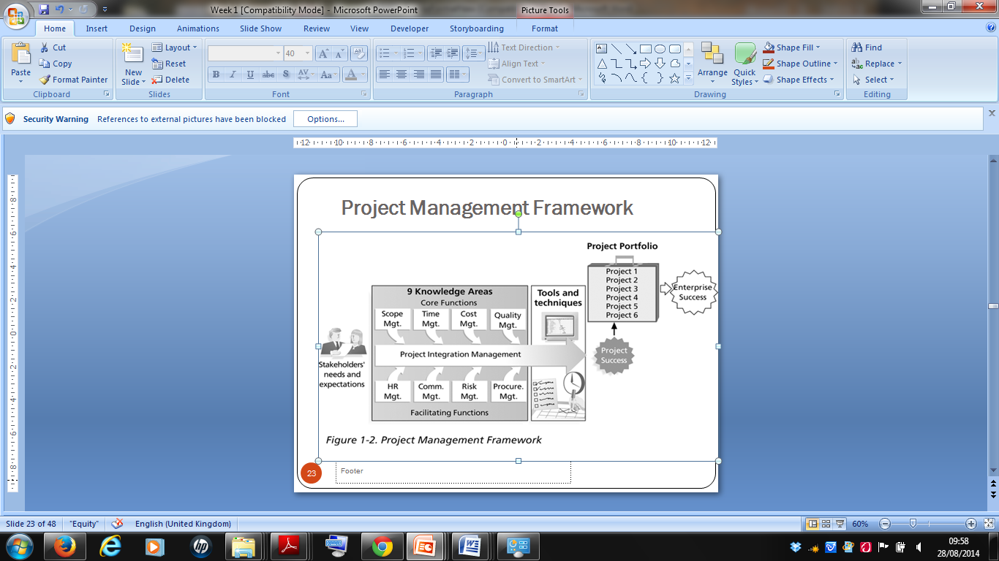
Figure2: Project management framework

Slide 32
Introduction Cont. Project Management Knowledge Areas (3)
KNOWLEDGE AREA | KEY TOOLS AND TECHNIQUES
Integration management | Project selection criteria, project management methodology, stakeholder analysis, project charters, project management plans, change control and configuration management, project review meetings, project management software.
Scope management | Project scope statements, requirements analysis, work breakdown structures, statements of work, scope management plan, scope change control.
Time management | Activity definitions, duration estimating techniques, project network diagram, critical path analysis, critical chain scheduling, Gantt charts, resource leveling, crashing, fast tracking
Cost management | Activity cost estimating techniques, net present value and payback analysis, reserve analysis, earned value management, cost management plan, financial software

Slide 33
Introduction Cont. Project Management Knowledge Areas (4)
KNOWLEDGE AREA | KEY TOOLS AND TECHNIQUES
Quality management | Cost-benefit analysis, quality control charts, Pareto diagrams, quality audit, statistical methods.
Human resource management | Organizational charts, interpersonal skills, motivation techniques, communication techniques, team building and contracts, roles and responsibilities matrices, resource leveling, resource histogram, conflict management techniques
Communication management | Stakeholder identification, communication mgt plan, communication media methods, communications infrastructure, status reports, conflict management
Risk management | Rick mgt plan, risk identification, probability/impact analysis, risk ranking, variance/trend analysis, risk reporting.
Procurement management | Make or buy analysis, procurement contracts, requests for proposals or quotes, source selection, negotiating, procurement performance management, payment systems

Slide 34
Top Ten Most Demand IT Skills

